Slide 1
The Presbytery of Carlisle
Silver Spring Presbyterian Church
Mechanicsburg, PA, December 3, 2019
Adapting to a World That’s Changed

Slide 2
Learning Lab: Becoming a Corps of Discovery
Cheryl Galan, Interim Executive Presbyter

Slide 3
“The church today is at a divine moment.
A crossroads.
At its best, we have always been
a Corps of Discovery.
Followers of Jesus have always been
small bands of people
willingly heading into uncharted territory
with a mission worthy of our utmost dedication.”
–Tod Bolsinger, Canoeing the Mountains
Notes:
Today, we’re going to talk about a leadership model for uncharted territory. And we begin with the above quote From Tod Bolsinger.
So let’s think of ourselves, of Carlisle Presbytery, as a Corps of Discovery, a body of 44 congregations, led by pastors and elders, setting out on a mission:
To bring the healing, saving love of Jesus to expression, for the sake of real people, with real problems, today.
It’s not as simple as it sounds…Because….American life has changed radically over the past generation. The operative words are ‘has changed.’ We can no longer say, ‘things are changing.’ Now it is clear…change has happened…and it is impacting our churches

Slide 4
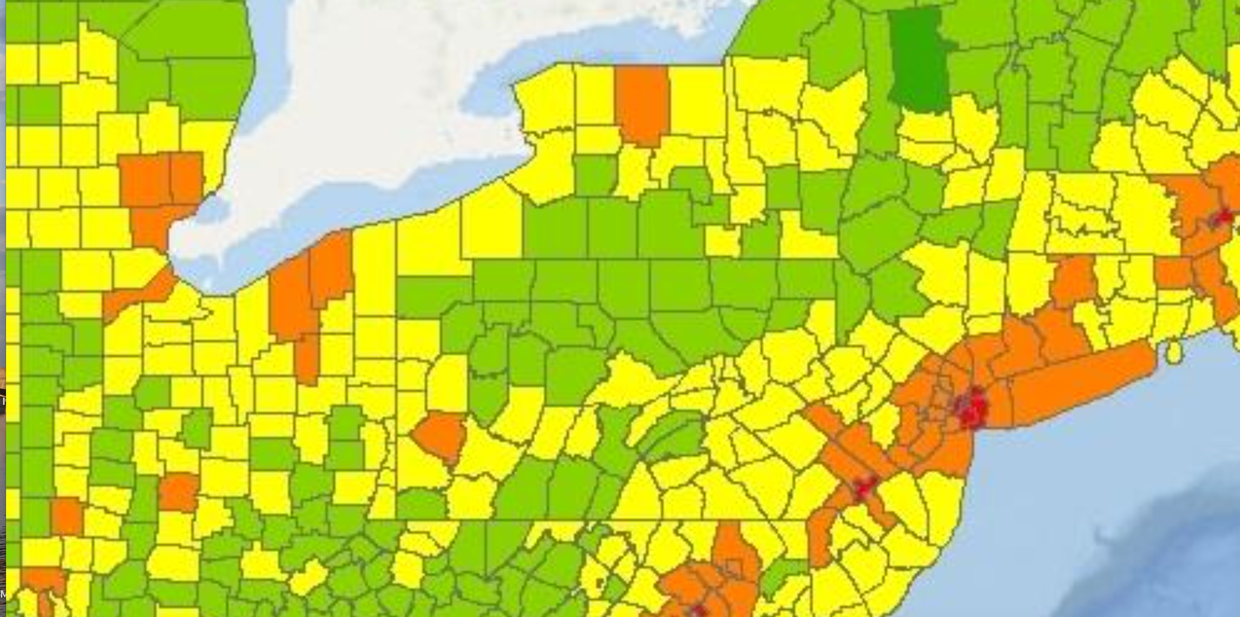
Population Density 2018
100-1,000 persons per square mile
Notes:
Population density of our region looks like this

Slide 5
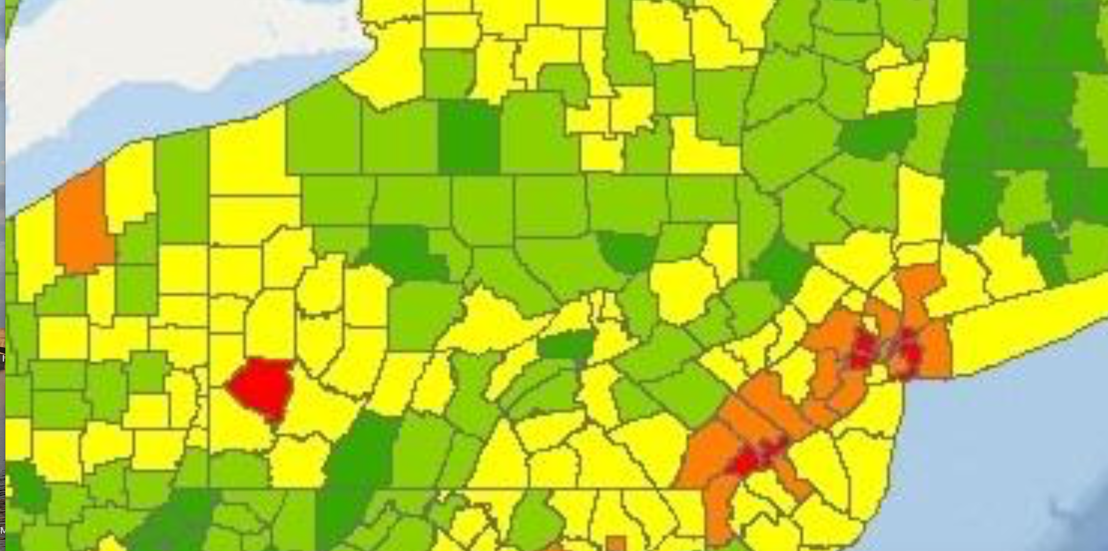
Membership Density 2019
0.1-1 and 1-10 Presbyterians per square mile
Notes:
Number of Presbyterians per square mile looks like this

Slide 6
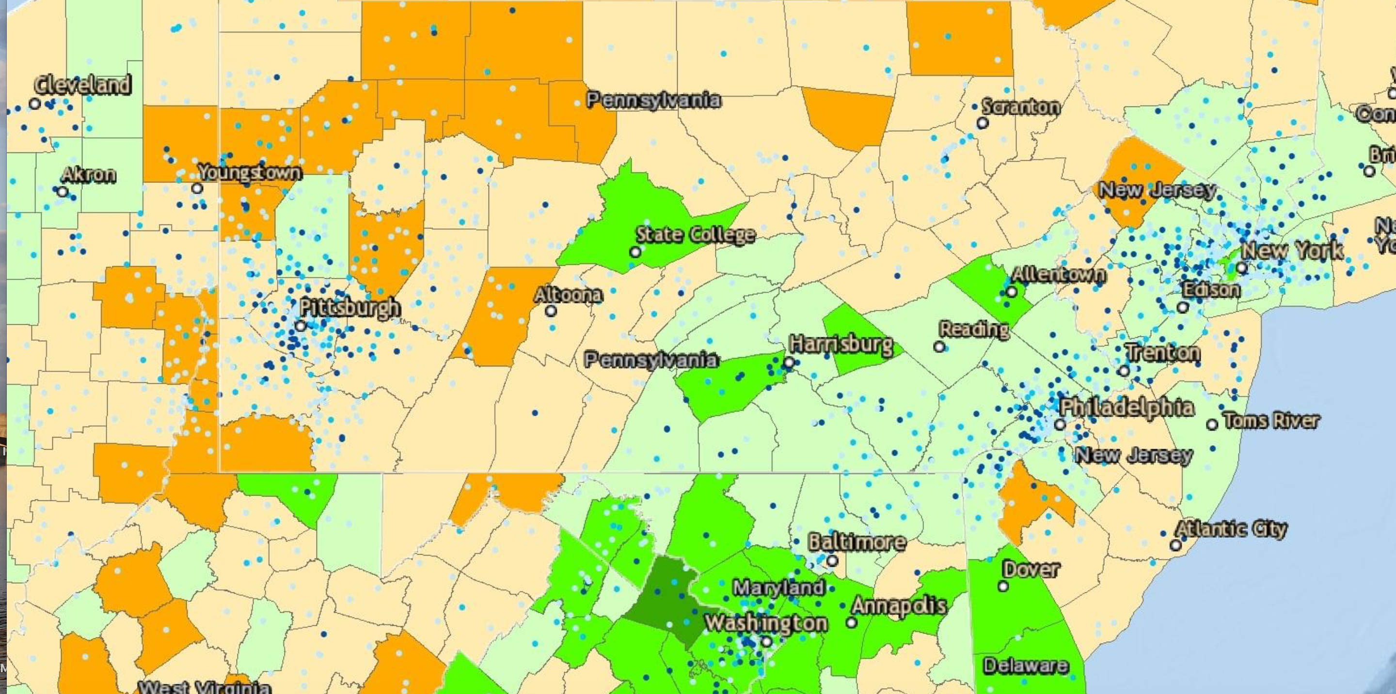
Congregations 2019
0%-5% and 5%-25% increment of population density
Notes:
The density of the population in our region is increasing by these percentages

Slide 7
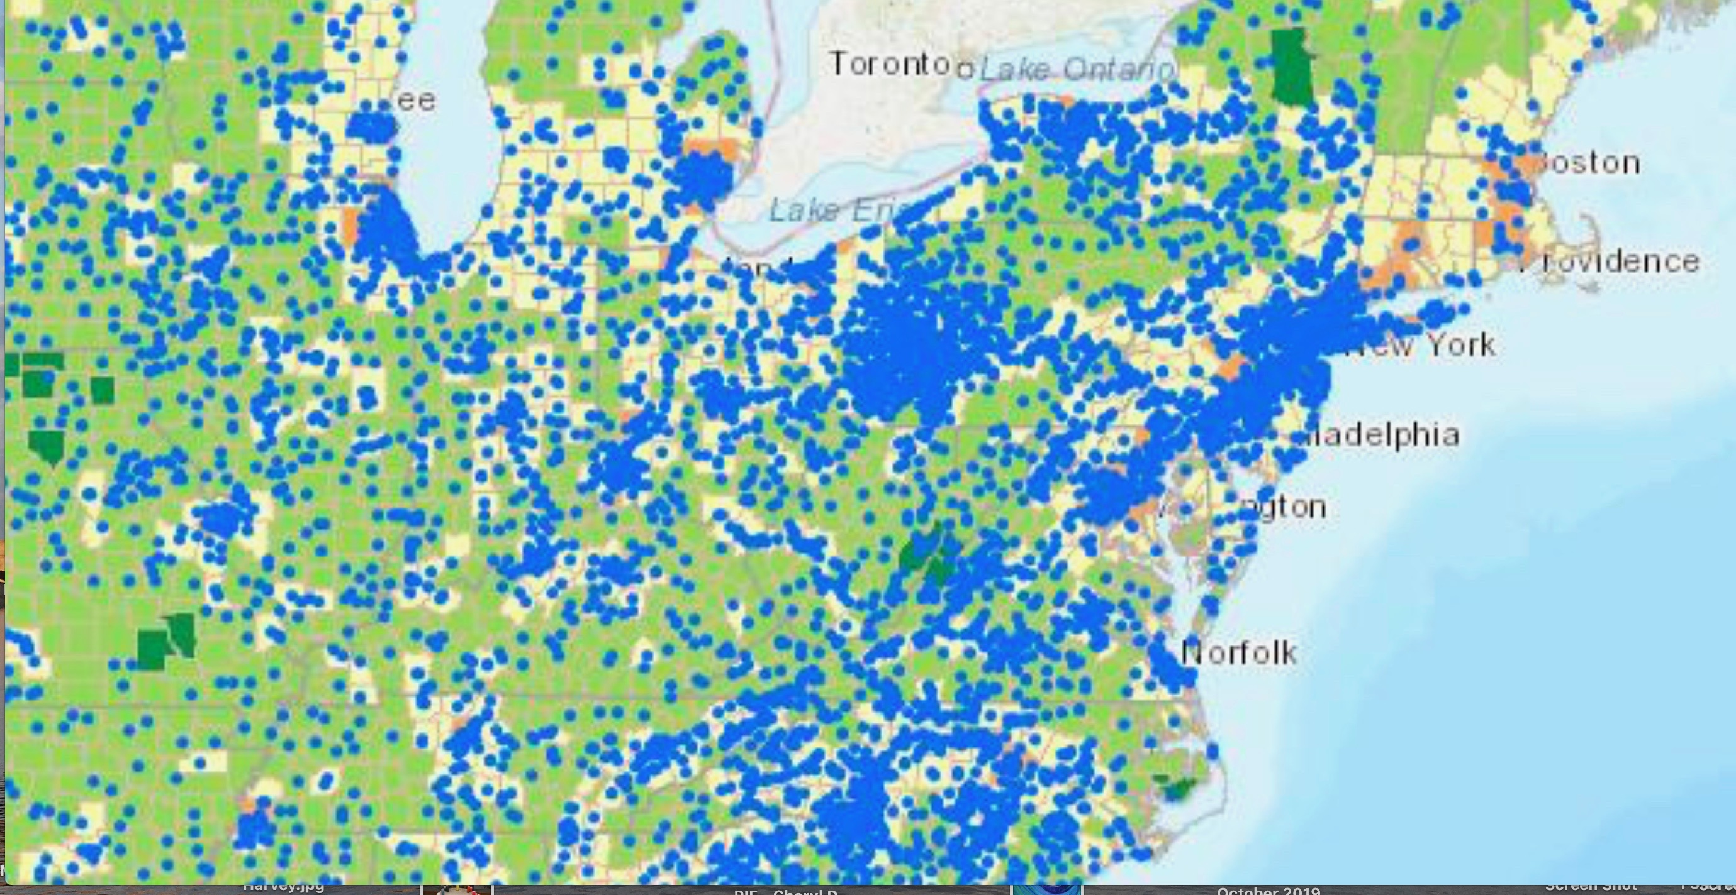
Population Density 2024
  10-100 persons per sq.mi./100-1,000 persons per sq. Mi.
Notes:
By the year 2024, our population density is anticipated to look like this

Slide 8
Today, congregations are….
All Denominations Carlisle Presbytery
85% Fewer than 250 66%
64% Fewer than 100 41%
12% Between 250 and 1,000 34%
3% More than 1,000 0

Slide 9
The ‘Nones’ and ‘Undesignateds’
are growing
    2007 2014
Unaffiliated 16.1% 22.8% + 6.7%
  Atheist 1.6 % 3.1% + 1.5%
Agnostic 2.4% 4.0% + 1.6%
Nothing 12.1% 15.8% + 3.7%

Slide 10
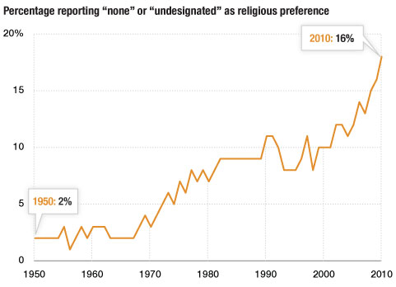
“Type a quote here.”
–Johnny Appleseed

Slide 11
2009 Church Attendance
Percentage by State
12.9%
10.4%
WA
NH
16.0%
25.2%
11.1%
10.0%
MT
ND
VT
ME
12.4%
OR
20.2%
11.5%
9.8%
23.5%
MN
13.2%
MA
ID
19.7%
NY
12.1%
SD
WI
18.9%
16.1%
WY
MI
14.5%
RI
20.9%
22.2%
17.5%
CT
NE
IA
18.1%
PA
13.5%
9.8%
3.1%
18.3%
20.0%
OH
NJ
14.6%
NV
UT
13.8%
IL
IN
15.3%
16.4%
14.6%
CA
DE
“Type a quote here.”
CO
20.8%
19.5%
WV
17.1%
MD
KS
MO
20.7%
VA
KY
22.2%
20.3%
13.2%
20.8%
TN
NC
AZ
15.5%
OK
24.7%
21.8%
NM
AR
SC
–Johnny Appleseed
21.3%
25.2%
25.9%
GA
0.0% to 13.2%
MS
AL
13.2% to 17.1%
17.2%
25.8%
17.1% to 20.8%
TX
LA
20.8% to 25.9%
12.7%
AK
14.0%
FL
13.0%
HI

Slide 12
Growth or Decline in the
Percentage of the Population
Attending a Christian Church from
2000 - 2009
-8.8%
WA
-11.7%
-9.4%
-14.2%
NH
-13.5%
MT
ND
-16.6%
ME
-15.2%
VT
OR
-21.1%
-12.0%
-14.9%
-13.1%
-20.7%
-16.2%
MA
ID
SD
MN
WI
NY
-21.4%
-15.2%
-8.4%
RI
WY
MI
-15.8%
-12.8%
-10.1%
-14.3%
CT
NE
IA
-10.3%
PA
-14.9%
“Type a quote here.”
-1.5%
-6.2%
-11.3%
-8.2%
OH
NJ
-10.3%
-5.9%
NV
UT
-10.0%
IL
IN
-11.7%
DE
CA
CO
-8.6%
WV
-6.2%
-8.3%
KS
-8.5%
-6.8%
VA
MD
MO
KY
-7.3%
-10.8%
-5.1%
TN
NC
-12.6%
-14.8%
OK
–Johnny Appleseed
AZ
NM
-2.6%
-6.5%
AR
SC
-3.8%
-9.3%
-5.4%
AL
GA
MS
-10.7%
-12.3%
TX
LA
-14.2%
AK
-10.3%
FL
-4.3%
HI

Slide 13
Today…..
Churches more than 40 years old decline in membership by 2% a year
Only one-third of historic congregations (founded before 1900) reported an increase in the number of regularly participating adults.
The best time to engage a church in facing questions about its future sustainability is when it’s around 75 members. We typically wait till they’re 50 … or 30 … or fewer.

Slide 14
Today….
Of those involved in churches:
65% are of the ‘Builders’ generation - born before 1946
35% are Boomers (born after 1946 and before 1965)
15% are Busters/Gen X (born 1965-1976)
4% are Bridgers/Millenials (1977-1994)

Slide 15
Today, in Carlisle Presbytery…
11 of our 44 churches have a pastoral position that is not filled by an installed pastor.
Some of our churches - of various sizes - are challenged to find people (especially of younger generations) to serve on Sessions.
Notes:
1) YOU ARE NOT ALONE, but WE are part of current that’s swept through our nation and our region. What Phyllis Trible calls The Great Emergence and Tod Bolsinger says is God taking God’s people into uncharted territory for the sake of the world God so loves.
2) AND IT’S NOT YOUR FAULT. THERE IS NOTHING YOU COULD HAVE DONE To PREVENT THESE CHANGES FROM HAPPENING. Navigating these challenges requires that we stay out of the shame and blame parts of our brain.

Slide 16
Discussion Questions:
Of these changes: population density, attendance, membership, leadership, and age demographics, which are currently impacting your congregation? How?
How do you see your congregation responding to these changes?
What opportunities is God giving us in these challenges?

Slide 17
Today…
“Congregations across all traditions, types and sizes appear to have the capacity to succeed in the midst of the changing American landscape.”

Slide 18
By Adapting to a world that’s changed…
not merely to survive but to thrive!
To bring the healing, saving love of Jesus to expression, for the sake of real people, with real problems, today…
And they are, themselves, transformed.
Notes:
If you’ve been reading Canoeing the Mountains, you will know that Lewis and Clark’s Corps of Discovery was looking for a water route across the continent, but ran out of water when they hit the Rockies.
Since you Can’t canoe over mountains, continue their journey, the Corps would have to change their entire approach.
The same is true for the churches in Carlisle Presbytery today.

Slide 19
Adapting…
“We need to press on to the uncharted territory of
making traditional churches
missionary churches.”
-Tod Bolsinger, Canoeing the Mountains
Notes:
Another way to put it: Making hIstoric churches, mission outposts (as they once were)

Slide 20
We don’t know how to do this…
“The culture for which we know how to be church
disappeared 15 years ago.”
        The mission field is right outside our
        sanctuary doors,
requiring us to be transformed
so we can participate in Christ’s mission
to those beyond the 17.5% of Pennsylvanians
who attend a Christian church.

Slide 21
We Become a Corps of Discovery….
        …where both leaders and
        followers LEARN because
        a thoroughgoing change
        in functions of leadership is needed.
Notes:
This is hard. We weren’t trained for this.
We are trained as teachers, worship leaders, counselors.
Some of us may be trained as social workers, program providers, and community organizers…..
And now, “It’s like we woke up one morning and found ourselves ministering in a strange land where we don’t understand the customs, language or values….and our training
doesn’t seem to be working the way it used to.
It is tempting to throw up our hands and say NO….I can’t. I don’t want to. It’s not fair.
I don’t have time. I don’t have energy….or resources….our partners
who will join me as I try to figure this out.
It’s also tempting to jump quickly to fix what we perceive is the problem. To tinker by re-structuring, Or to rely on what we already know, even though it’s not working.
But these challenges can’t be solved with our existing knowledge or skill. In the changed environment we face, our tried and true default actions, programs, and strategies are moot

Slide 22
Becoming a Corps of Discovery….
“We are facing an
Adventure-or-Die
moment.”

Slide 23
“You don’t try harder
with what you know
but instead you
start a new adventure…
where there are experiments,
new and unexpected discoveries
and ultimately new perceptions.”
–Tod Bolsinger, Canoeing the Mountains
Notes:
And you are NOT the first…here are some faces you may recognize, of adventurers
from times past, who can help us see what is asked of us:

Slide 24

We engage the long tutorial of trial and error,
of observing and experimenting and interpreting.

Slide 25
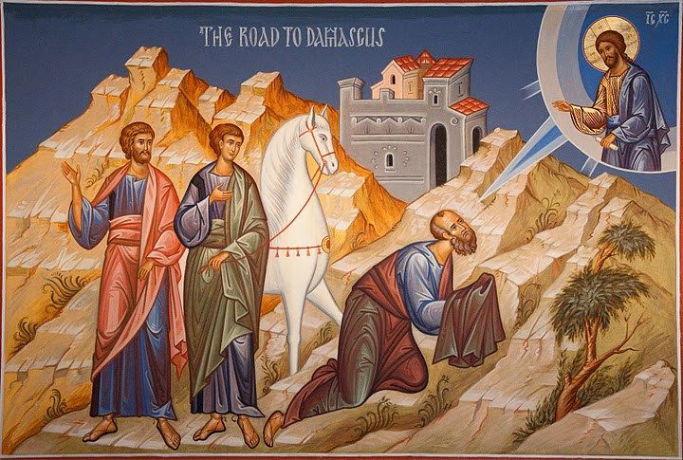
We face the requirement to be changed
and attend to our own resistance to change.

Slide 26
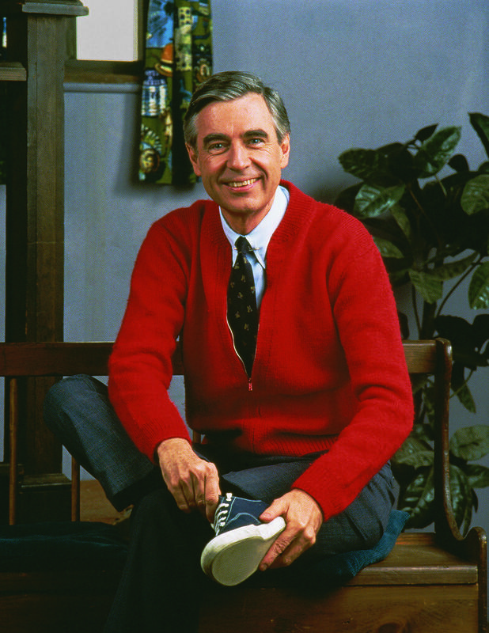
We embody the transformation needed
and invite others into it.

Slide 27
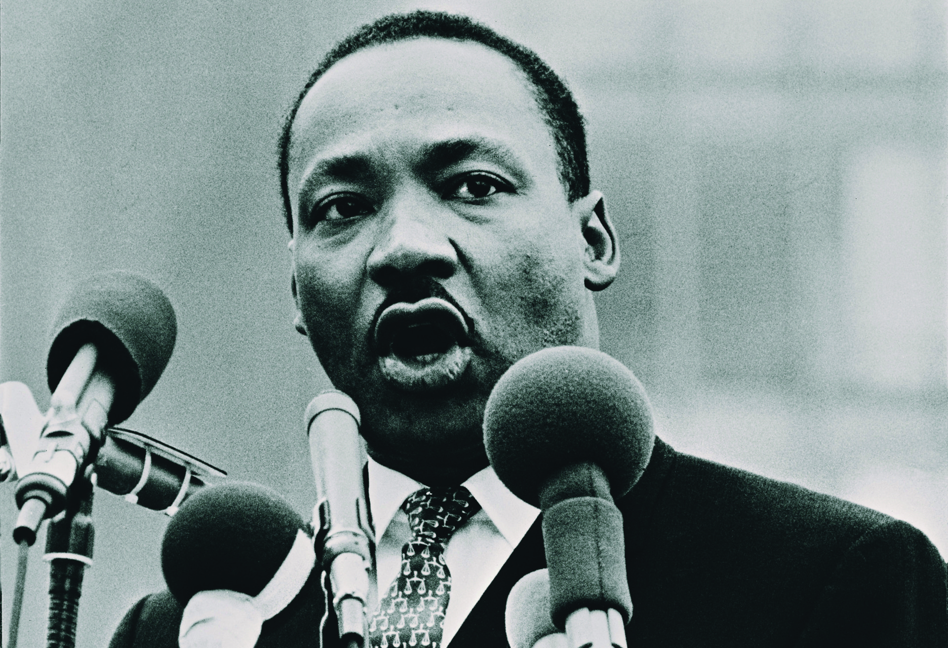
We accept the unavoidable reality
that a new solution will result in loss.

Slide 28
You’re not the first and you’re not alone
Who are your role models/heroes,
in discovery and starting new adventures?
(From the Bible, history, stories or movies, your own life…
who has modeled the way of discovery and adventure, in ways you find compelling?)
What could you learn from them, to help you become a lead adventurer with your congregation?

Slide 29

The Corps Gathers for Worship
Blue Christmas Worship
11:00 in the
Meeting House

